Slide 1

Data Science using Azure SQL Server for everyone

Slide 2

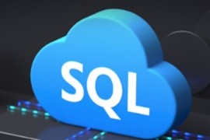




Thank you to our sponsors!
This event was powered by

Slide 3

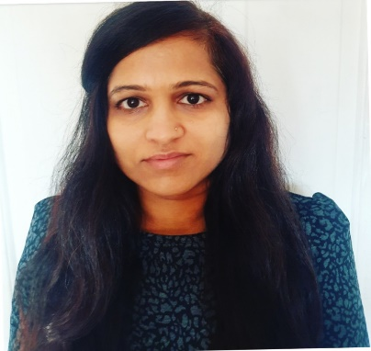
Presenter
Alpa Buddhabhatti
Azure Consultant, Cluster Reply
https://www.linkedin.com/in/alpabuddhabhatti/

Slide 4
In this session, I am going to show 100% Demo for Creating Azure SQL server. How to access it in Azure portal and in SSMS. Basic queries , Firewall rules and basic data science queries.
Fri, 20 Aug 2021, 7:50am - 8:50am (60 minutes)in Eastern Daylight Time (UTC-04:00)
That's Fri, 20 Aug 2021 at 12:50 PM in your timezone
Room 1

Slide 5
Agenda
What is Data Science ?
What is Azure SQL Server?
Demo
Installation of Azure SQL Server
How to connect ASQL using Azure Portal?
How to connect ASQL using SSMS?
How to connect ASQL using ADS?
Basic Data Science Queries

Slide 6
1. What is Data Science?

Slide 7
What is Data Science?
A branch of computer science
Dealing with capturing, processing, and analyzing data
Provides meaningful information based on large amounts of complex data or big data

Slide 8
Data Science Process
COLLECTION OF DATA
PARSE OF DATA & NORMALIZATION
CREATE AROUTINE TO RUN ON DATA
IDENTIFYING
Trends, Patterns, Correlations and Visualization

Slide 9
What does a data scientist do?
Gathers data
Parses
Normalizes
Creates routines to run on the data
A pattern, trend, or just a helpful visualization

Slide 10
What are type of data?
1
Numerical : Quantities data e.g Age
2
Categorical : Qualitative e.g. Gender
Ordinal – Mixing of above e.g. Feedback rating for session
3

Slide 11
2. What is Azure SQL?

Slide 12
What is Azure SQL?
A family of managed, secure, and intelligent products that use the SQL Server database engine in the Azure cloud.
https://docs.microsoft.com/en-us/azure/azure-sql/azure-sql-iaas-vs-paas-what-is-overview

Slide 13
Demo
1. Installation of Azure SQL Server

Slide 14
Demo
2. How to connect ASQL using Azure Portal?

Slide 15
Demo
3. How to connect ASQL using SSMS?

Slide 16
Demo
4. How to connect ASQL using ADS?

Slide 17
Demo
5. Basic Data Science Queries

Slide 18
Key Takeaway
Everyone can do data science
Need to asked lot of question about data
Know your data
Pick a coding language
Select Tools
Pick Cloud technology

Slide 19
Thank you!!!!

Slide 20
Q&A
Alpa Buddhabhatti
Azure Consultant, Cluster Reply
https://www.linkedin.com/in/alpabuddhabhatti/

Slide 21
Useful Links
Channel 9: Videos for developers from the people building Microsoft Products & Services (msdn.com)
Microsoft Events
Exam DP-100: Designing and Implementing a Data Science Solution on Azure - Learn | Microsoft Docs
PowerPoint Presentation (sqltutorial.org)

